Slide 1
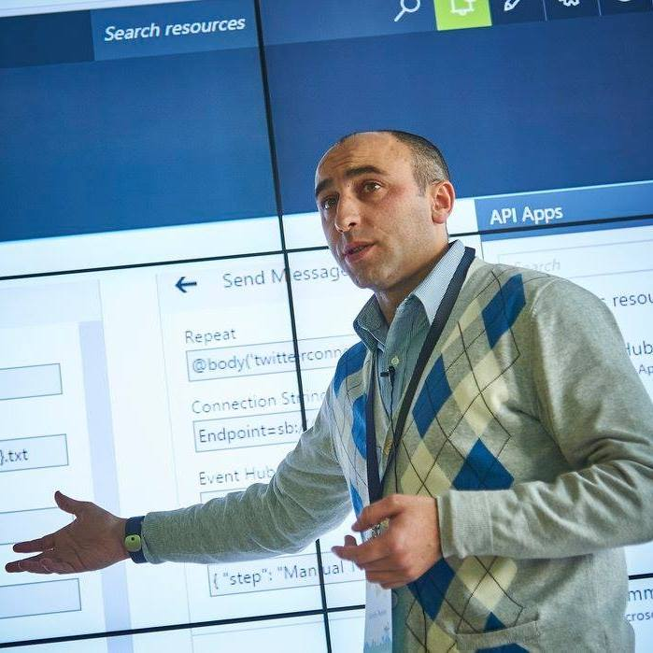
Sandro Pereira
Azure MVP | Head of Integration @ DevScope
BizTalk Server 2020: Migration Path

Slide 2


Sandro Pereira
Head of Integration @DevScope
Microsoft Azure MVP
sandro.pereira@devscope.net
linkedin.com/in/sandropereira
@sandro_asp
https://blog.sandro-pereira.com/
Public speaker
Father
Book author: BizTalk Mapping Patterns and Best Practices
+351 223 751 350
www.devscope.net
Notes:
Interested in all things integration – which of course includes MS Flow

Slide 3
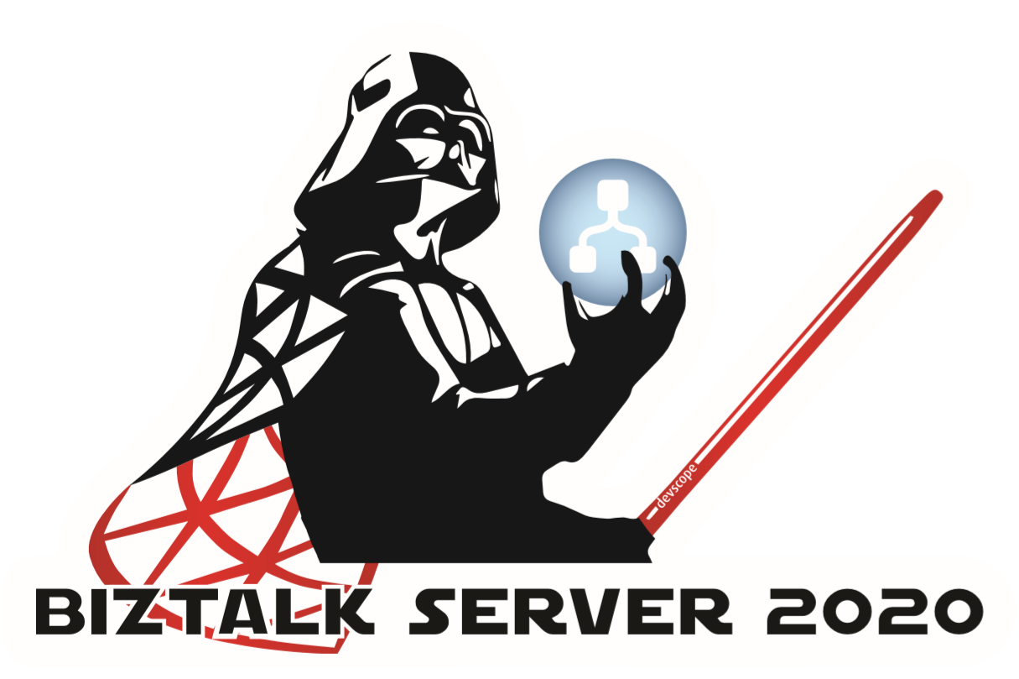
BIZTALK SERVER 2020 STICKER
https://github.com/sandroasp/BizTalk-Server-Logos-Stickers/tree/master/BTS2020/Lord-BizTalk-Darth-Vader
https://aka.my/lyt

Slide 4

WHY SHOULD YOU UPGRADE YOUR BIZTALK SERVER PLATFORM?

Slide 5


ENVIRONMENTAL
CONSTRAINTS
LOST OF SUPPORT
BizTalk Server heavily depends on the performance of SQL Server and Windows Server itself. So moving to the latest platform should provide considerable performance gain (depending on the scenario) on the same application code base.
Nearing end of life (EOF) mainstream support.
Lifecycle for BizTalk Server, HIS, OS and SQL Server
FEATURE PACKS
NEW FEATURES
The ability to have new features thru Feature Packs without having to migrate your BizTalk Server platform to a new version
Better features for Hybrid Integration
Application Lifecycle Management with VSTS
Privacy/Security (Always Encrypted, TLS1.2)
XSLT 3.0
ADMINISTRATOR & DEVELOPER PRODUCTIVITY ENHANCEMENTS
MOVE TO CLOUD
The ability to run BizTalk Server on the cloud as IaaS
(BizTalk Server VM running on Azure)
New Visual Studio & new Administration Console features

Slide 6


BIZTALK SERVER: MIGRATION PATH
What are your options?
BUILDING DREAMS SINCE 2000
MIGRATING TO AZURE
MIGRATING TO BIZTALK SERVER 2020

Slide 7


HOSTED AZURE SERVERS
MIGRATING TO AZURE
Migrating your on-premise server or Virtual Machines to Azure Virtual Machines. (IaaS)
Supported since BizTalk Server 2013
AZURE SERVICES
Migrate your existing BizTalk Server Applications to Azure Integration Services (AIS) .
Azure Integration Services—API Management, Logic Apps, Service Bus, and Event Grid—work together to provide a complete solution for integrating both cloud and on-premises applications.
75% of my clients are running there BizTalk Server environments in Azure (VM).
10% in other host providers
5% in-house

Slide 8




MIGRATE BIZTALK SERVER TO AZURE SERVICES
It is a complete redesign into your integration solution… even if you use the new BizTalk Migration tool
DIFFERENT WAY TO THINK AND WORK
THERE ISN'T A ONE TO ONE MAPPING FEATURES
RAPID RELEASE CADENCE
MISSING SOME FEATURES
There is no MessageBox, you should use Service Bus if you want to persist your messages.
You have to implement
Pub-Sub
BizTalk Server has a release cadence of major version each 2/3 years. Azure is completely different
For example, Business Rules Engine doesn't exist.
On Azure there are many ways/features to archive one task.

Slide 9




MIGRATING TO BIZTALK SERVER 2020
What are your options? How to migrate from a previous version to Biztalk Server 2020
2020

Slide 10


IN-PLACE UPGRADE
MIGRATING TO BIZTALK SERVER 2020
Only supported from BizTalk Server 2016 to BizTalk Server 2020 in certain conditions!
Too risky to perform in production environments
MIGRATE SOLUTIONS TO NEW ENVIRONMENT
In more than 16 years working with BizTalk Server, I never perform an in-place upgrade on a production environment.
The easier, safer and ideal way to migrate to a new version of BizTalk Server .
100% of my clients use this approach!

Slide 11

OPERATING SYSTEM
Windows Server 2016 Yes
Windows Server 2012 R2 No
Windows 10 Yes
Windows 8.1 No
IN-PLACE UPGRADE
SQL Server
SQL Server 2016 Yes
SQL Server 2014 No
BizTalk Server 2020 Editions
Evaluation No
Branch Yes to Branch
Developer Yes to Enterprise
Standard Yes to Standard and Enterprise
Enterprise Yes to Enterprise
Supported upgrade paths
Constraints
SQL Adapter Removed
TIBCO Enterprise Message Service Adapter 64 bits support only
BizTalk Accelerator for RosettaNet There’s a bug that requires install hotfix
Legacy SQL Adapter (Deprecated): https://techcommunity.microsoft.com/t5/biztalk-server-team-blog/legacy-sql-adapter-deprecated/ba-p/1407055

Slide 12


AS-IS
Without any non-mandatory changes
Analyse and check all the points to improve and then migrate/recreate the integration project will all the improvements or new requirements.
Open BizTalk Visual Studio solution - Fix the .NET Version - Fix Strong Name Key - Fix deployment properties ….and rebuild!
MIGRATE SOLUTIONS TO NEW ENVIRONMENT
MIGRATE & IMPROVE
With all non-mandatory changes
Requires a deep analysis to the existing code and speak with the business (or different teams) to grab all kind of information to get highlight on what's need to be improve.
The testing phase will tend to be more rigorous, "more important" and longer.
Migration options

Slide 13
EFFORT TO MIGRATE FOR BIZTALK SERVER 2020
EFFORT MIGRATING YOUR BIZTALK SERVER SOLUTIONS TO BIZTALK SERVER 2020
Migrate Source Code/BizTalk Applications
Deployment
RosettaNet
10%
15%
Maps
23 %
Community Frameworks
10%
Building your BizTalk Server environments.
Environments configurations
30%
Pipelines
2%
Adapters
2%
Orchestrations
3%
EDI
23 %
Testing your BizTalk Server Applications
Tuning and optimizations
55%
Schemas
3%
SQL and SAP Adapter
23%

Slide 14
EFFORT TO MIGRATE ARTIFACTS/COMPONENTS FOR BIZTALK SERVER 2020
JUST REBUILD: Open VS, Fix .NET version and deploy
WARNING: Adapters registration ID’s don’t conflict
JUST REBUILD: Open VS, Fix .NET version and deploy
WARNING: Old SAP Adapter (BTS2006) and Old SQL Adapter (2016) were removed
Custom Adapters
Schemas
JUST REBUILD: Open VS, Fix .NET version and deploy
WARNING: String concat behaviors issues, for example can’t concat 6 string inside expression shape.
Custom Pipelines
JUST REBUILD: Open VS, Fix .NET version and deploy
Orchestrations
JUST REBUILD: Open VS, Fix .NET version and deploy
WARNING: Functoids ID’s don’t conflict
DEPRECATED with no replacement
Nevertheless, is still there and is 100% compatible
Custom Functoids
BAM Portal

Slide 15
EFFORT TO MIGRATE ARTIFACTS/COMPONENTS FOR BIZTALK SERVER 2020
New feature: XSLT 3.0 - New extensible model for runtime map execution, out of box wiring to work with Saxon XSLT3.0.
70% JUST REBUILD – Open VS, Fix .NET version and deploy
CRITICAL WARNING: Starting from BizTalk Server 2013 there is a new Transformation engine XslCompiledTransform versus the XslTransform.
THEY ARE NOT 100% COMPATIBLE:
Change in Scripting Functoid Boolean Parameter Behavior (https://support.microsoft.com/en-us/kb/2887564)
Scripting functoid cannot return null out of an inline C# method
Passing Null values around chain functoids in not simple anymore
Helper classes used in maps cannot use overloading
Only public methods may be called from XPath expressions
Passing a node to a helper class as a XpathNodeIterator now requires a Node.MoveNext to select the first node
…
But sometimes these errors can only be checked/view in execution time.
Maps
Trading Partner Management (TPM) was re-engineered in BizTalk Server 2010. Because of that Parities cannot be directly migrated from order versions. You have to use BizTalk Server Party Migration Tool.
Native Adapters
Old SAP Adapter (BTS2006) and Old SQL Adapter (2016) were removed, so all generated schemas need to be recreated.
EDI

Slide 16
EFFORT TO MIGRATE ARTIFACTS/COMPONENTS FOR BIZTALK SERVER 2020
Business Rules Engine
Export/Import
RFID
Removed. You need to redesign your solutions
Human Workflow Services
Removed.
Should never have existed.

Slide 17




FROM ... TO BIZTALK SERVER 2020
How hard can it be?
BizTalk Server 2013 to 2016
BizTalk Server 2010
BizTalk Server 2009 to 2004
BizTalk Server 2002 to 2000
EASY
MEDIUM/EASY
MEDIUM/HARD
EXTREMELY HARD
Depending on the features and solutions it can give you some work. But normally, if everything is well done it is easy.
Depending on the features and solutions it can give you some work.
These are easy migrations
You need to re-write everything again.

Slide 18
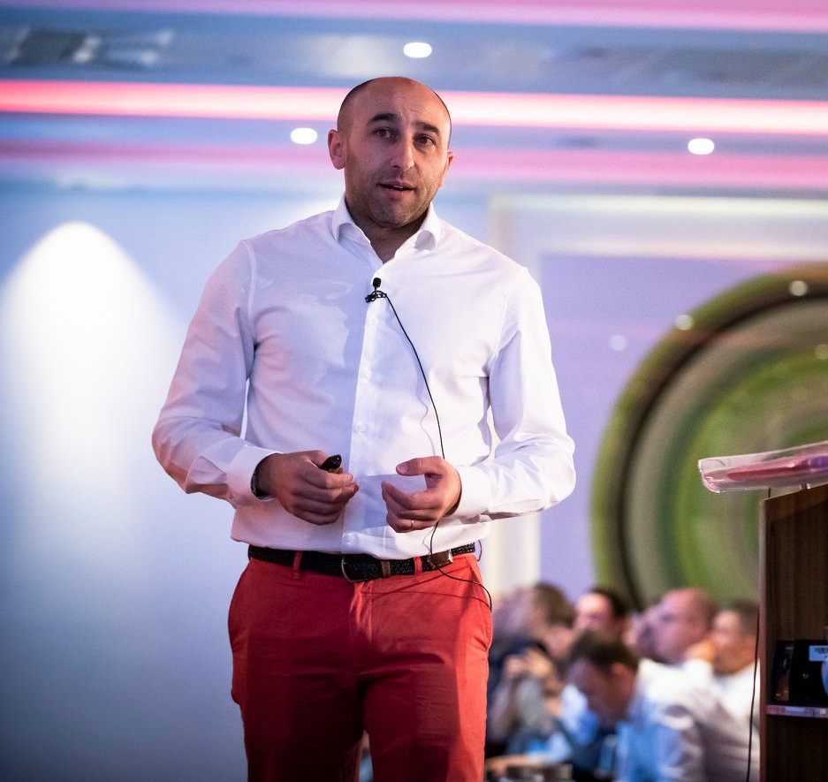

BIZTALK MIGRATION BOOK
STATUS
IN PROGRESS
SANDRO PEREIRA
Azure MVP (Integration)
BizTalk Server Wikipedia
TOM CANTER
I guess the goal of this book is to demystify and clarify the BizTalk Server migration process and help both implementation teams as decision makers to be aware of all the considerations that need to be taken into account when planning your migration and hopefully helping you carry out these tasks.
Founder and owner of Canter Integration
Former MVP and a BizTalk Server Guru!
BizTalk Server Storage Account

Slide 19

Thanks
DevScope
+351 223 751 350
support@devscope.net
https://pt.linkedin.com/company/devscope
@DevScope
www.devscope.net
Sandro Pereira
sandro.pereira@devscope.net
linkedin.com/in/sandropereira
@sandro_asp
https://blog.sandro-pereira.com/
SANDRO PEREIRA
HEAD OF INTEGRATION @ DEVSCOPE
MICROSOFT AZURE MVP

